Slide 1
UIT2512 – Operating Systems Practices Lab
MINI PROJECT
CACHE MEMORY MANAGEMENT - VIDEO CACHE
Vemula Muni Karthik-3122 21 5002 120

Slide 2
CONTENTS
Problem Statement
Problem Description
Synopsis
Algorithm
Code Snippets
Output Screenshots

Slide 3
PROBLEM STATEMENT
Design and implement a cache memory management system for optimizing data retrieval and storage in a computer system.Implementation of a cache memory management system with the primary goal of optimizing data retrieval and storage in a computer system.

Slide 4
PROBLEM DESCRIPTION
This project undertakes the design and implementation of a cache memory management system, focusing on key elements such as cache organization, replacement policy, write policy, and cache coherency in a multiprocessor environment.
The cache organization aspect involves specifying parameters like size,associativity, and block size, with flexibility in choosing between direct-mapped, set-associative, or fully-associative configurations.
Implementation of a replacement policy, be it LRU, FIFO, or another, is crucial for efficient cache contentmanagement and minimizing misses.

Slide 5
SYNOPSIS
The cache memory size of the Algorithm we implemented is 3 frames.
Initially assuming the 3 frames are empty.
When the new video is loaded that will occupy a frame in cache memory and takes some time.
If video is already in cache memory it will be displayed within zero seconds.
FIFO and LRU has been used for video replacement technique.
In FIFO the video which is in 0 th index of the queue will be deleted and that frame will be allotted to the video that is searched.
In LRU the video that has been not used for a long time will be deleted and that frame will be allotted to the video that is searched.
If there is a space in queue no algorithm is used.

Slide 6
ALGORITHM
LRU Counters : o If using an LRU replacement policy, update counters to reflect the most recently used block.
Perform Read or Write Operation: o If the memory access is a read operation, return the data from the cache. o If the memory access is a write operation, update the cache and main memory based on the chosen write policy (e.g., write-through, write-back).
Performance Metrics : Track performance metrics such as hit rate, miss rate, and average memory access time for evaluation.

Slide 7
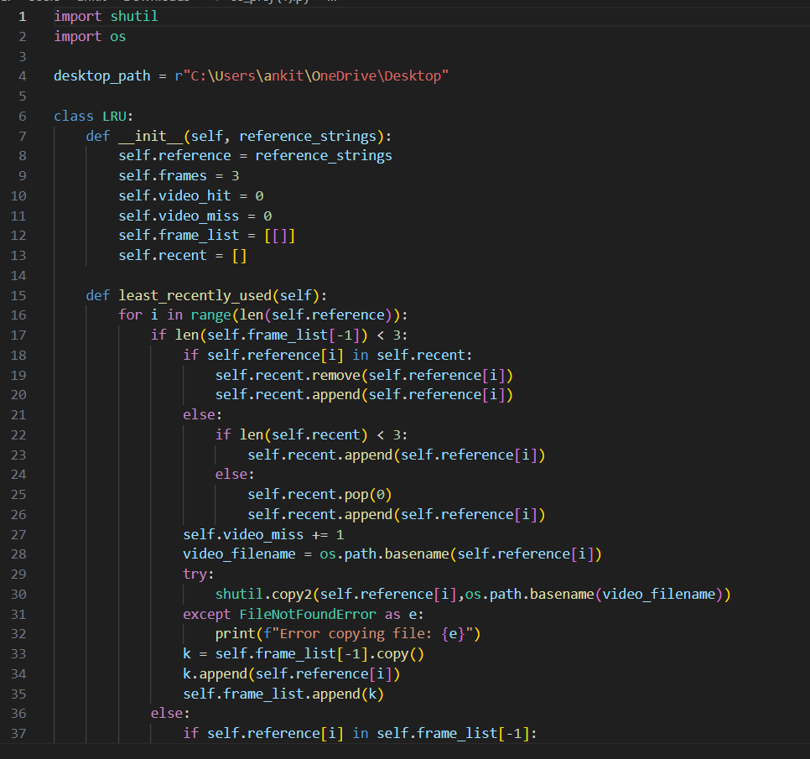
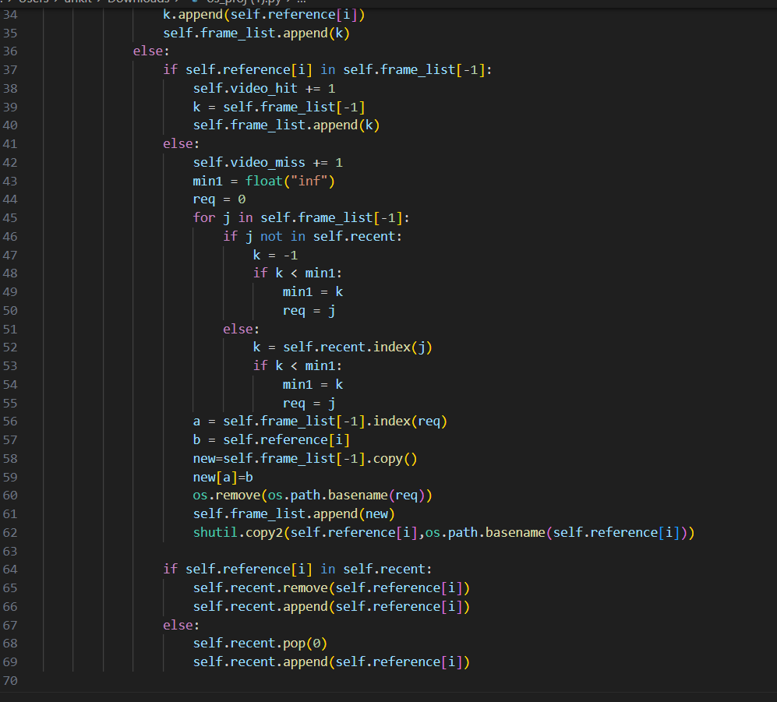
CODE SNIPPETS
Implementation of LRU ALGORITHM

Slide 8
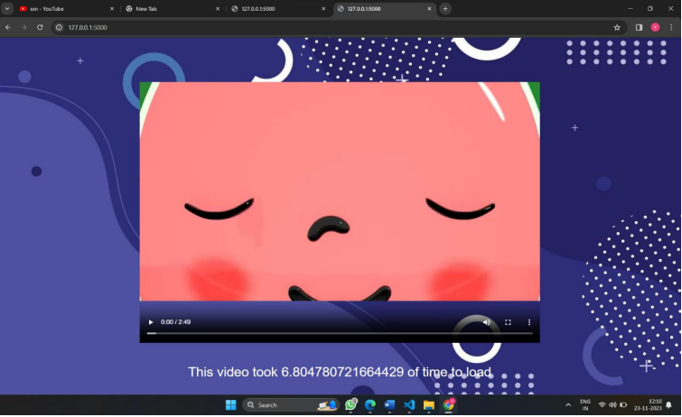
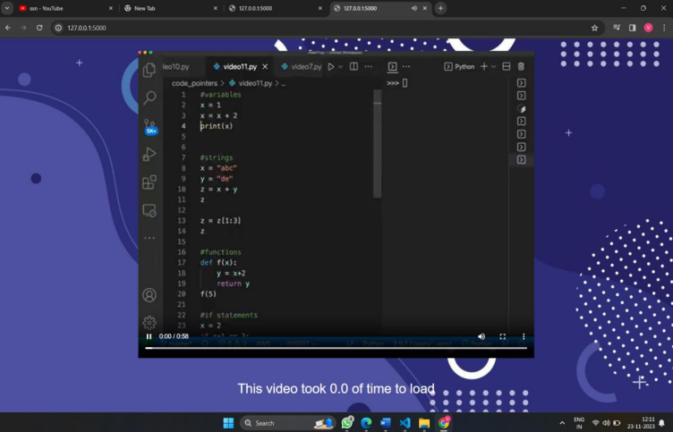
OUTPUT - SCREENSHOTS
Took more time due to page fault
Took 0 secs due to page hit

Slide 9
THANK YOU

